Slide 1
Welcome
To
Wonder World

Slide 2
Wonder World
Taj Mahal
Great Wall Of China
Crist the Redeemer
Petra
Machu Picchu
Colosseum
Angkor wat

Slide 3
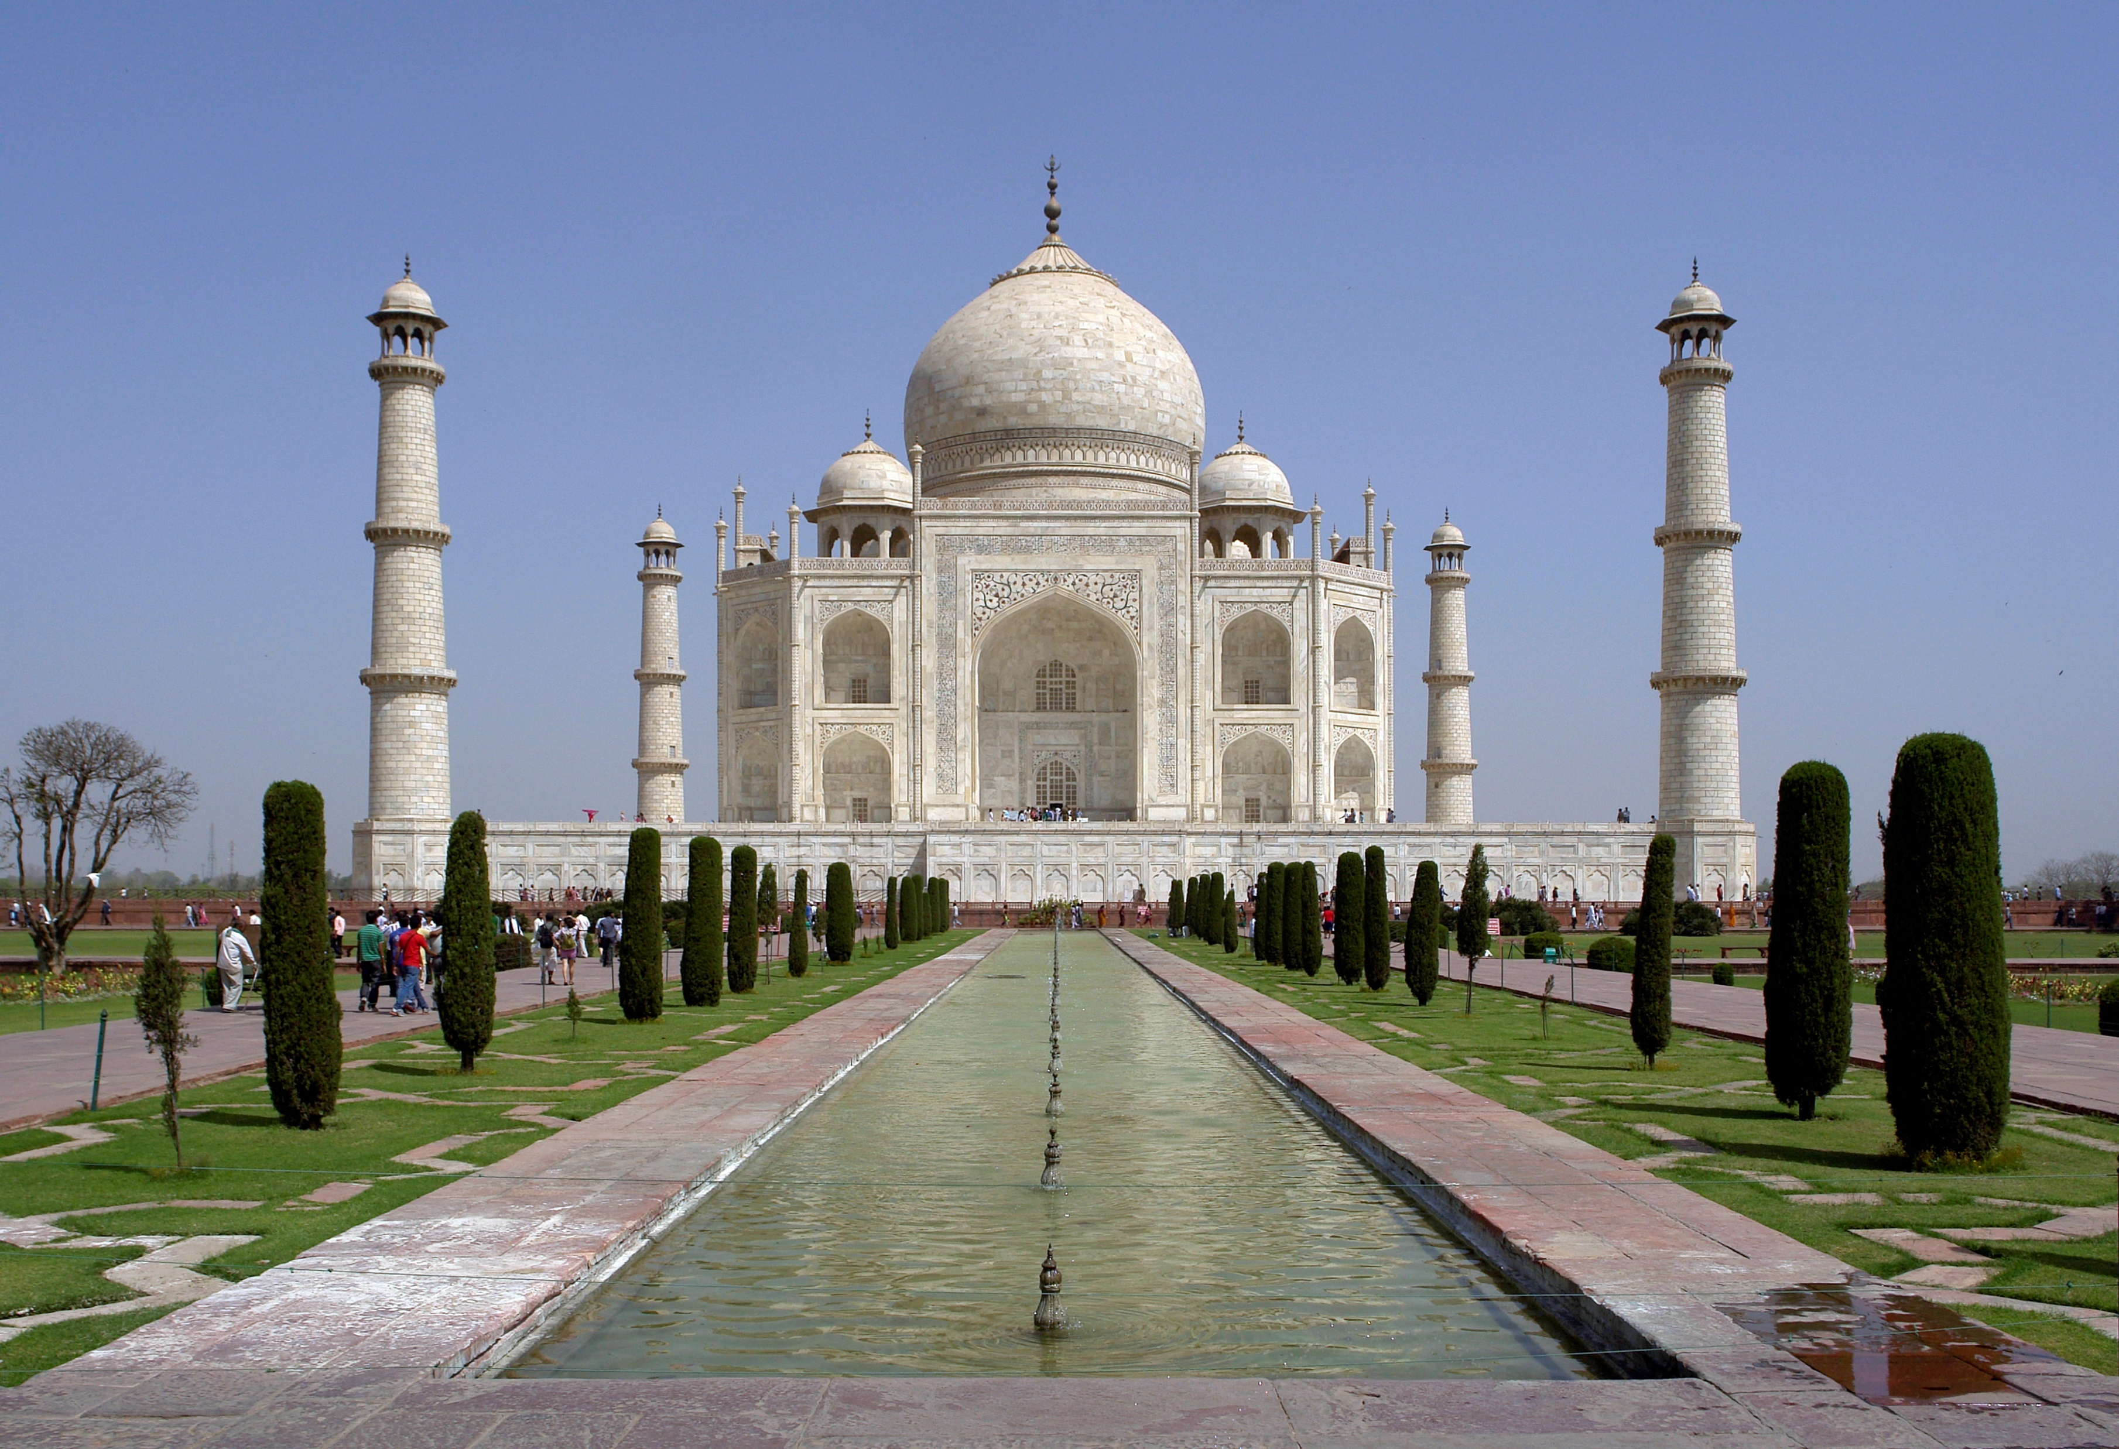
1.Taj Mahal
The Taj mahal is an ivory-white marble mausoleum on the south bank of the Yamuna river in the Indian city of Agra .It was commissioned in 1632 by the Mughal emperor Shah Jahan ,to house the tomb of his favourite wife Mumtaz Mahal.

Slide 4
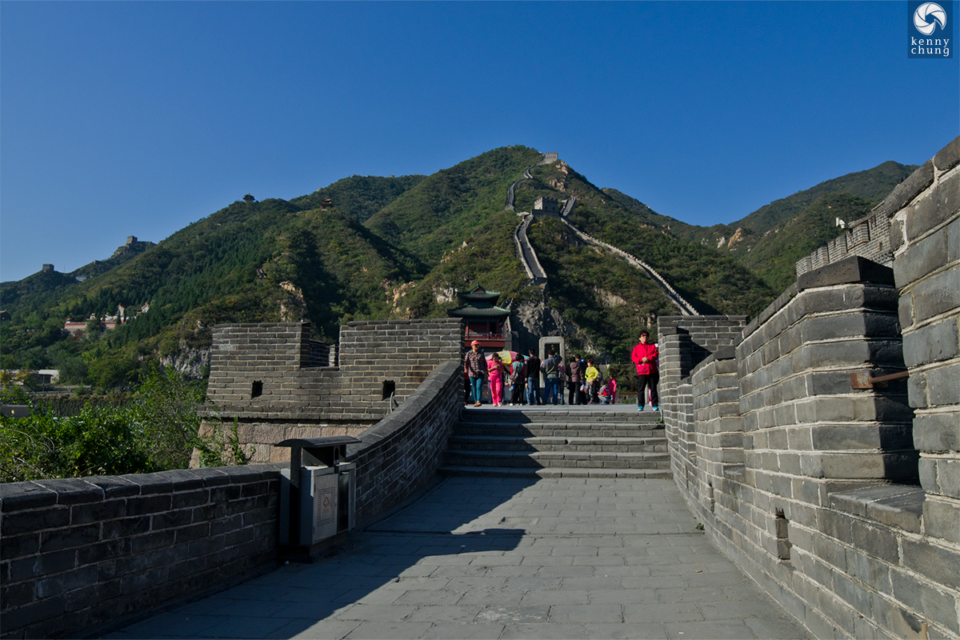
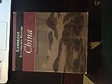
2.Great wall of China
The great wall of China is a series of fortifications that were built across the historical northern borders of ancient Chinese states and imperial China as protection against various nomadic groups from the Eurasian steppe. Qin Shi Huang, to protect his newly founded Qin dynasty.

Slide 5
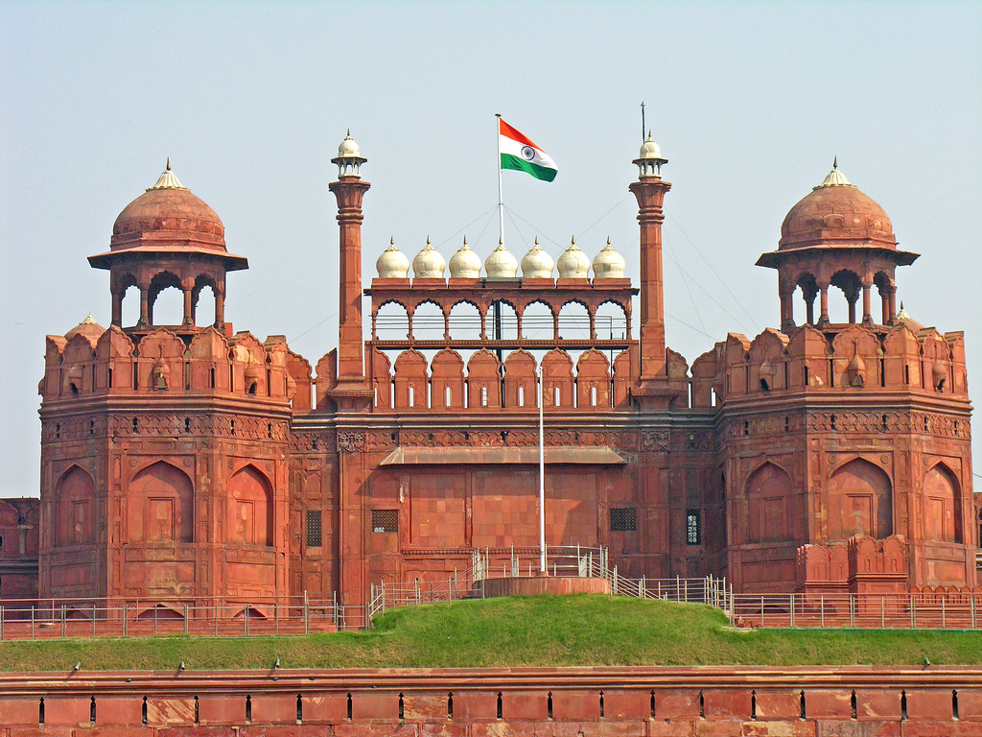
3.RedFort Fort
The Red Fort is located in Delhi , opposite the Chandani chowk market.it was built by the famous Mughal emperor Shah Jahan in1648. it is one of the historical structures of Delhi. Which known for its Architecture. Due to the use of red sandstone and marble.

Slide 6
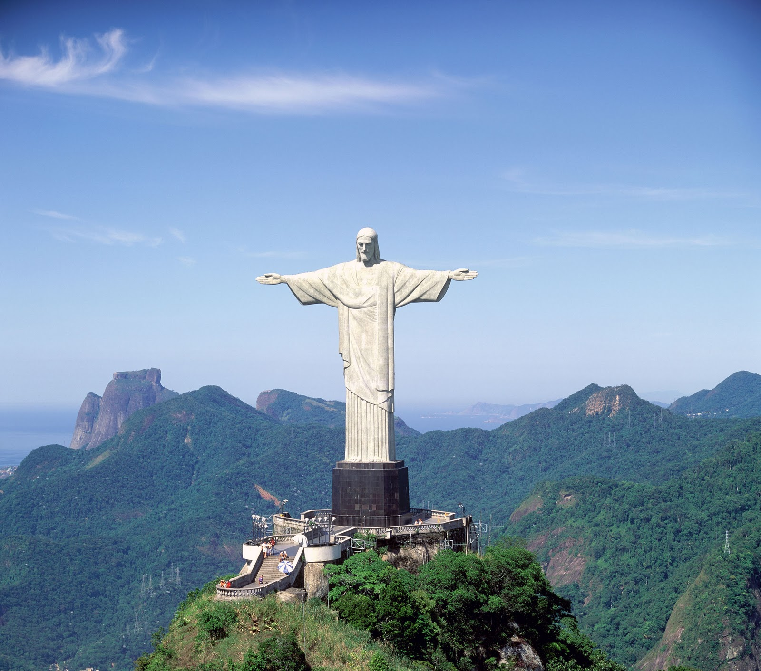
4.Christ the Redeemer
Crist the Redeemer is an art Deco statue of Jesus Crist in Rio de Janeiro, Brazil, created by French polish sculptor Paul Landowska and built by Brazilian engineer , Heritor da silva costa , in collaboration with French engineer Albert casquet.

Slide 7
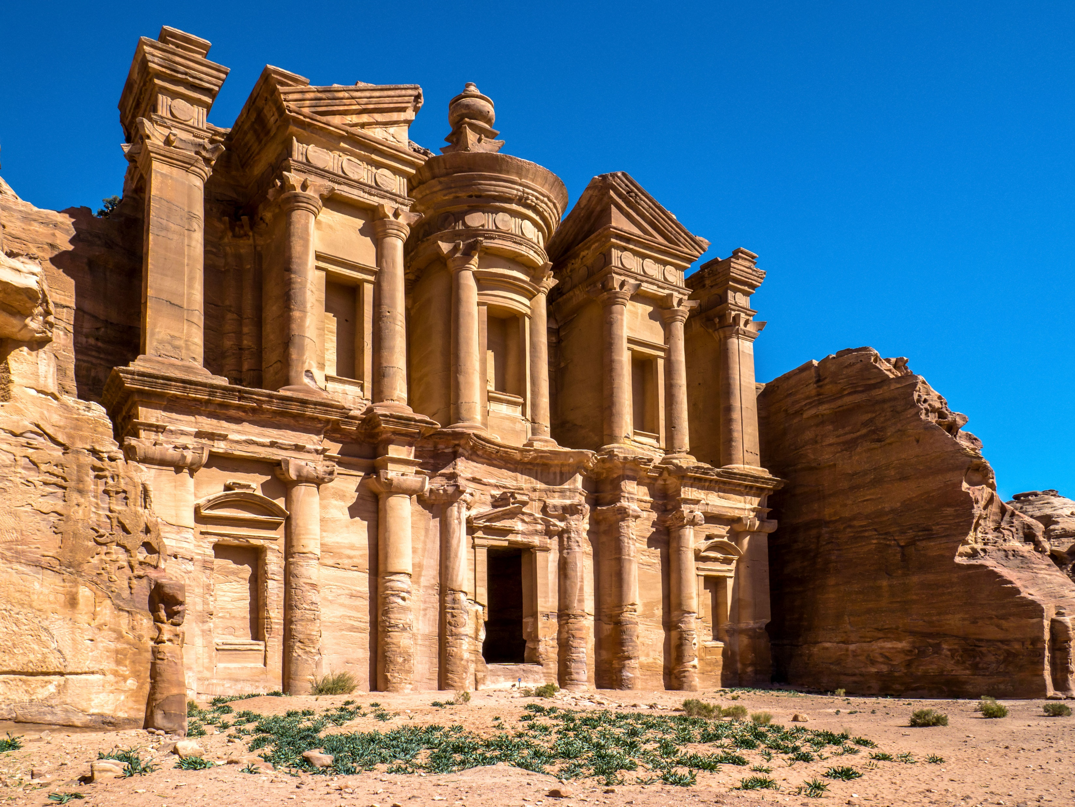
5.Petra
Petra originally known to its inhabitants as Raque or Raceme is a historic and archaeological. Built Possibly as early as 5th century BC.

Slide 8
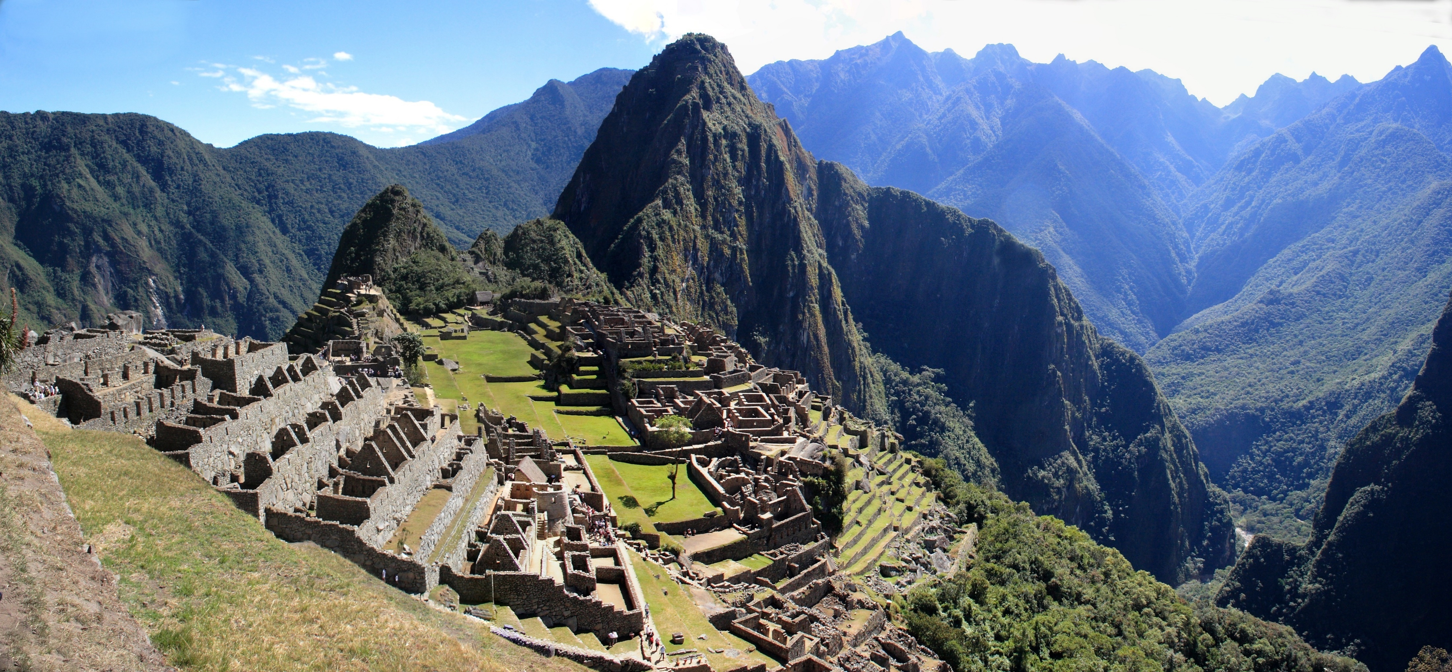
6.Machu Picchu
Machu Picchu is a 15th – century Inca citadel located in the Eastern Cordillera of southern Peru on a 2,430- meter (7,970ft)
Mountain ridge.

Slide 9
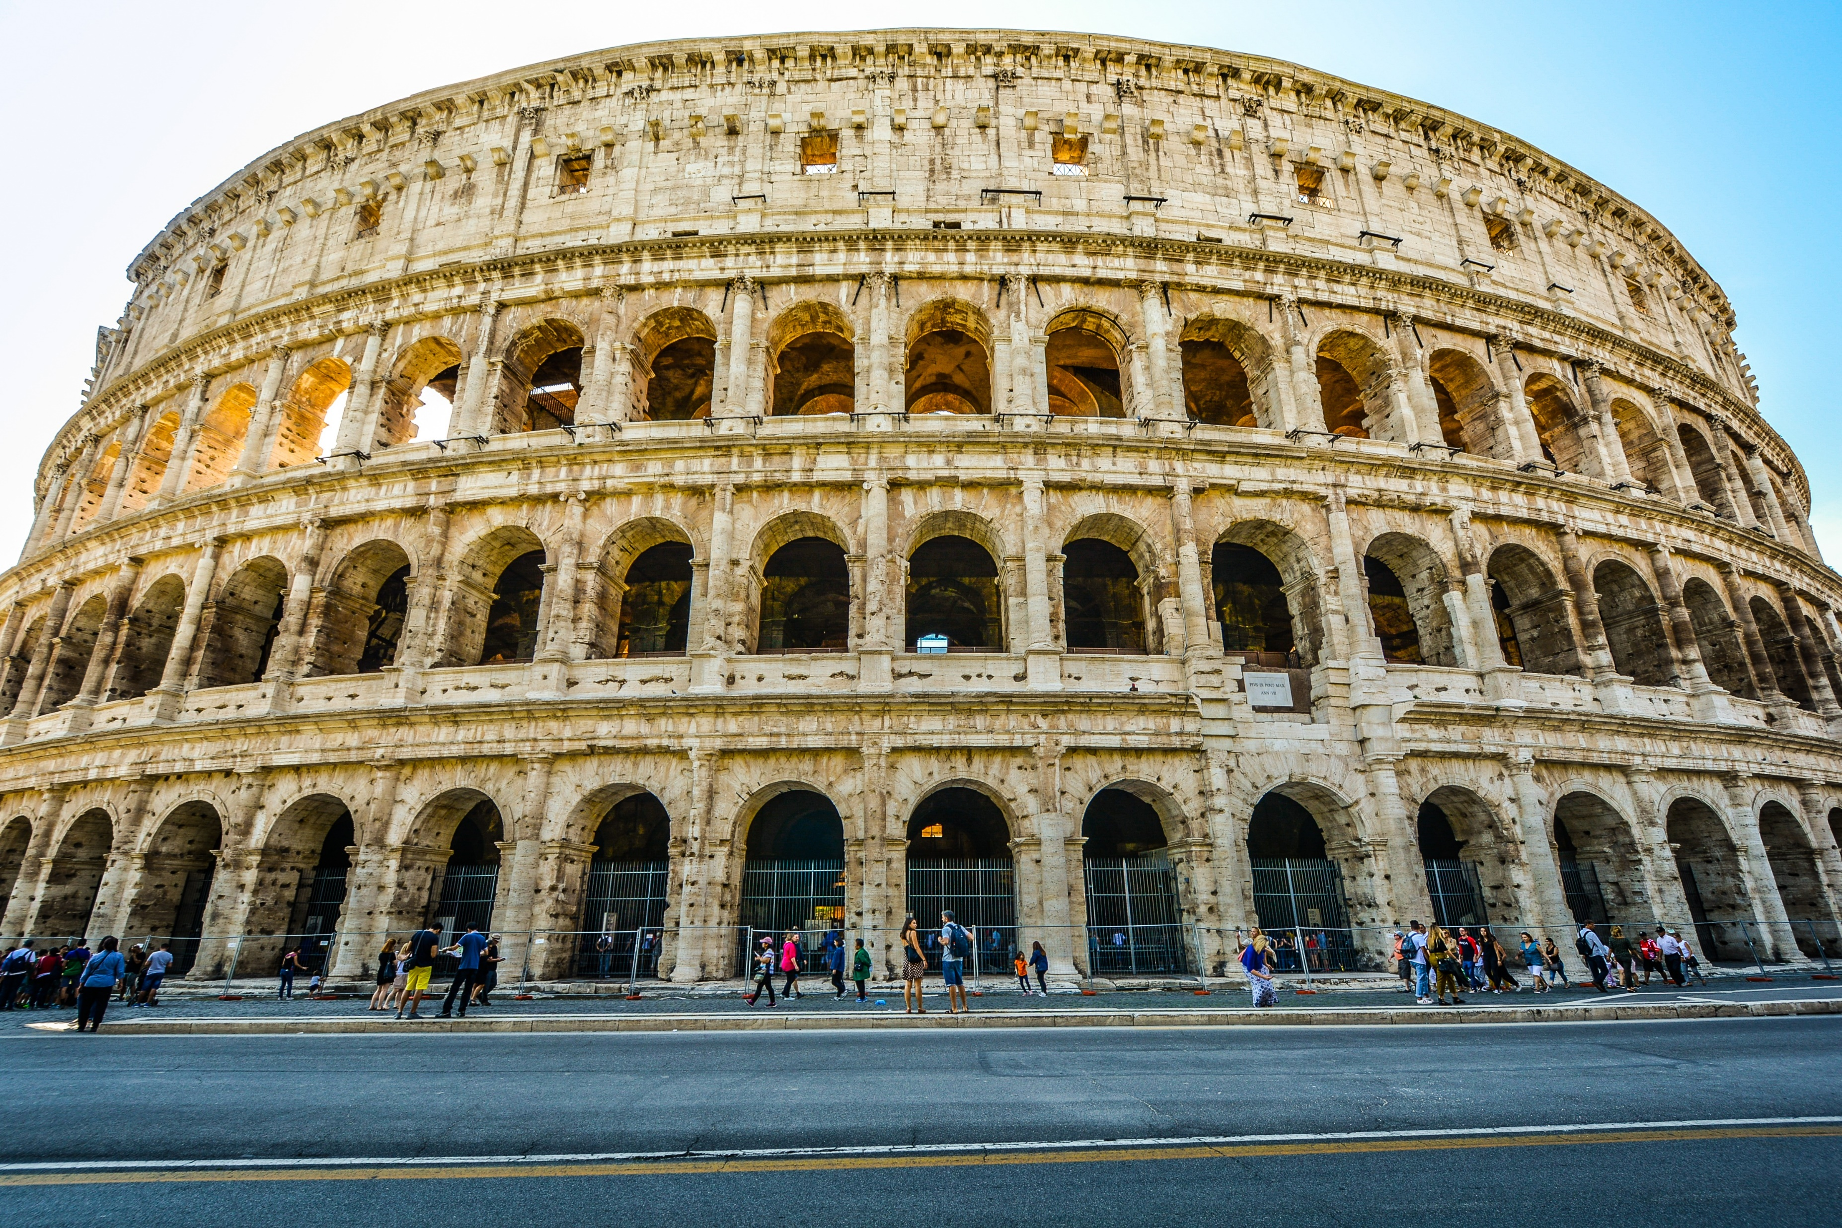
7.Colossemum
The colosseum is an elliptical amphitheatre in the centre of the city of Rome, Italy ,just east of the Roman Forum. It is the largest ancient amphitheatre ever built, and is still the largest standing amphitheatre in the world.

Slide 10
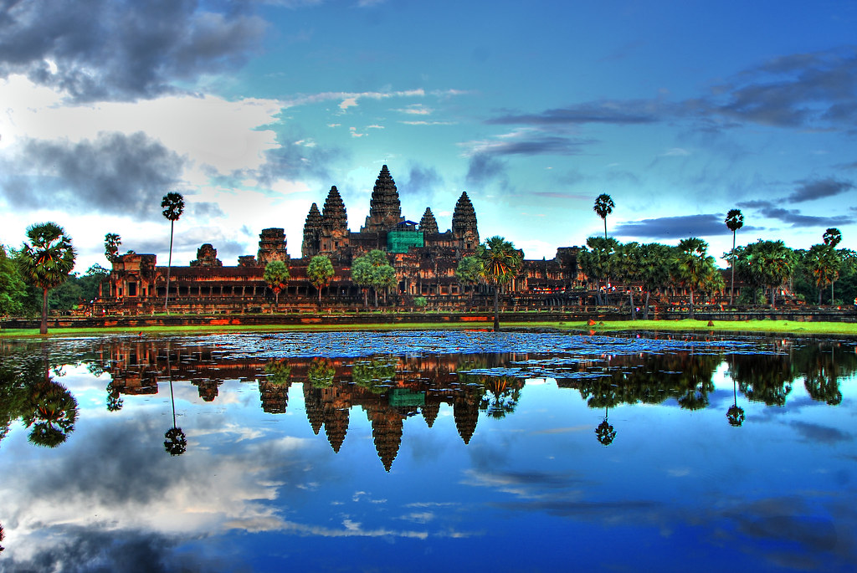
8.Angkor Wat
Angkor wat is a temple complex in Cambodia ,located on a site measuring 162.6 hectares. It reside within the ancient Khmer capital city of Angkor. The Guinness world record considers .

Slide 11

Thank you

